Slide 1
Facade Pattern
Aydın ŞAHİN

Slide 2
The Facade Pattern
Intent
Provide a unified interface to a set of interfaces in a subsystem. Facade defines a higher-level interface that makes the subsystem easier to use.

Slide 3
Motivation
Structuring a system into subsystems helps reduce complexity
Subsystems are groups of classes, or groups of classes and other subsystems
The interface exposed by the classes in a subsystem or set of subsystems can become quite complex
One way to reduce this complexity is to introduce a facade object that provides a single, simplified interface to the more general facilities of a subsystem

Slide 4
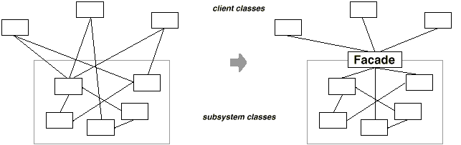
Motivation

Slide 5
Applicability
Use the Facade pattern:
To provide a simple interface to a complex subsystem. This interface is good enough for most clients; more sophisticated clients can look beyond the facade.
To decouple the classes of the subsystem from its clients and other subsystems, thereby promoting subsystem independence and portability

Slide 6
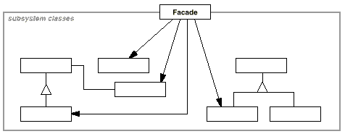
Structure

Slide 7
Concequences
Benefits
It hides the implementation of the subsystem from clients, making the subsystem easier to use
It promotes weak coupling between the subsystem and its clients. This allows you to change the classes the comprise the subsystem without affecting the clients.
It reduces compilation dependencies in large software systems
It simplifies porting systems to other platforms, because it's less likely that building one subsystem requires building all others
It does not prevent sophisticated clients from accessing the underlying classes
Note that Facade does not add any functionality, it just simplifies interfaces
Liabilities
It does not prevent clients from accessing the underlying classes!

Slide 8
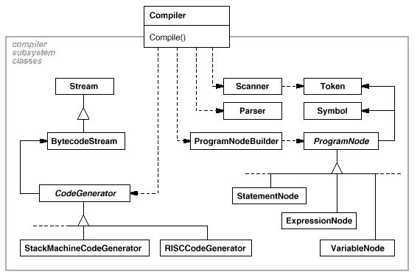
The Facade Pattern Example A compiler:

Slide 9
Demo

Slide 10
References
http://sourcemaking.com/design_patterns/facade
http://userpages.umbc.edu/~tarr/dp/lectures
http://en.wikipedia.org/wiki/Facade_pattern
http://www.java2s.com/Code/Java/Design-Pattern/FacadePattern2inJava.htm

Slide 11
THANK YOU

